Slide 1
Business Intelligence G. Mudare

Slide 2
Mining Frequent Itemsets without Candidate Generation

Slide 3
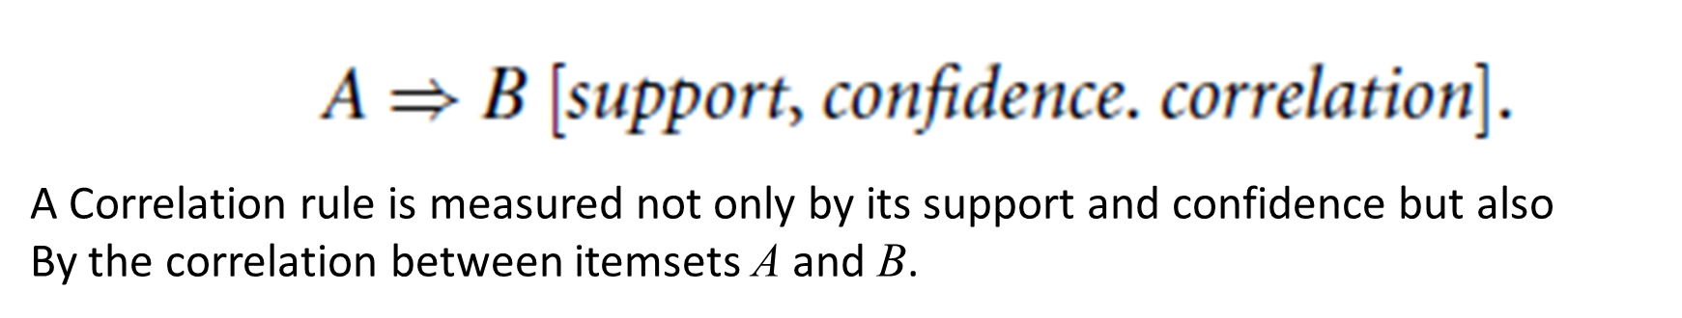
Association Analysis to Correlation Analysis
Sometimes the support and confidence measures are insufficient at filtering out uninteresting association rules.
To tackle this weakness, a correlation measure can be used to augment the support-confidence framework for association rules.

Slide 4

Correlation Measures
Lift is a simple correlation measure: and states:
The occurrence of itemset A is independent of the occurrence of itemset B if P(A UB) = P(A)P(B); otherwise, itemsets A and B are dependent and correlated as events.
The lift between the occurrence of A and B can be measured by computing
If the resulting value of this Equation is less than 1, then the occurrence of A is negatively correlated with the occurrence of B.
If the resulting value is greater than 1, then A and B are positively correlated, meaning that the occurrence of one implies the occurrence of the other.
If the resulting value is equal to 1, then A and B are independent and
there is no correlation between them.

Slide 5
LIFT
The Equation is equivalent to P(B/A)/P(B), or conf (A➔B)/sup(B), which is also referred as the lift of the association (or correlation) rule A➔B.
The Lift it assesses the degree to which the occurrence of one “lifts” the occurrence of the other.
eg
if A corresponds to the sale of computer games and B corresponds to the sale of videos, then given the current market conditions, the sale of games is said to increase or “lift” the likelihood of the sale of videos by a factor of the value returned by Equation

Slide 6
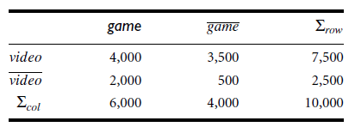
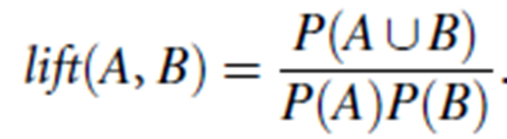
Correlation analysis using lift
A 2 x 2 contingency table summarizing the transactions
with respect to game and video purchases.
We want to study how the two itemsets, A and B, are correlated.
Let refer to the transactions that do not contain computer games, and refer to those that do not contain videos.
From the table
P(game) = 0:60,
P(video) = 0:75,
P(fgame; videog) = 0:40.
By Equation the lift is P(game, video)/(P(game)xP(video)) = 0.40/(0.60 x 0.75) =0.89.
Because this value is less than 1, there is a negative correlation between the occurrence of {game} and {video}.
The numerator is the likelihood of a customer purchasing both, while the denominator is what the likelihood would have been if the two purchases were completely independent.
Such a negative correlation cannot be identified by a support confidence framework.

Slide 7
Correlation analysis
The second correlation measure that we study is the χ2 measure
The χ2 statistic tests the hypothesis that A and B are independent.
The test is based on a significance level, with (r-1)x(c-1) degrees of freedom.
To compute the χ2 value, we take the squared difference between the observed and expected value for a slot (A and B pair) in the contingency table, divided by the expected value.
This amount is summed for all slots of the contingency table.

Slide 8
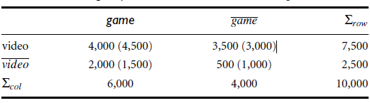
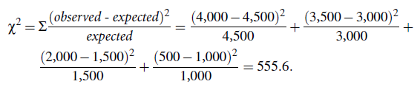
Contingency table, with the expected values
To compute the correlation using χ2 analysis, we need the observed value and expected value
Because the χ2 value is greater than one, and the observed value of the slot (game, video) = 4,000, which is less than the expected value 4,500, buying game and buying video are negatively correlated.

Slide 9


How to calculate Expected
Correlation analysis of categorical attributes using χ2. Suppose that a group of 1,500 people was surveyed. The gender of each person was noted
Each person was polled as to whether their preferred type of reading material was fiction or nonfiction. Thus, we have two attributes, gender and preferred reading.

Slide 10

Other correlation measures, all confidence
all confidence:
Given an itemset X = {i₁, i₂, : : : , i_{k}}, the all confidence of X is defined as

Slide 11
Constraint-Based Association Mining
A data mining process may uncover thousands of rules from a given set of data, most of which end up being unrelated or uninteresting to the users
The best is to have the users specify their expectations as constraints to confine the search space
This strategy is known as constraint-based mining..

Slide 12
Mining constraints
Knowledge type constraints: These specify the type of knowledge to be mined, such as association or correlation.
Data constraints: These specify the set of task-relevant data.
Dimension/level constraints: These specify the desired dimensions (or attributes) of the data, or levels of the concept hierarchies, to be used in mining.
Interestingness constraints: These specify thresholds on statistical measures of rule interestingness, such as support, confidence, and correlation.
Rule constraints: These specify the form of rules to be mined.

Slide 13

Metarule-Guided Mining of Association Rules
Metarules allow users to specify the syntactic form of rules that they are interested in mining.
The rule forms can be used as constraints to help improve the efficiency of the mining process.
In general, a metarule forms a hypothesis regarding the relationships that the user is interested in probing or confirming.

